Slide 1
Invoice calculation

Slide 2
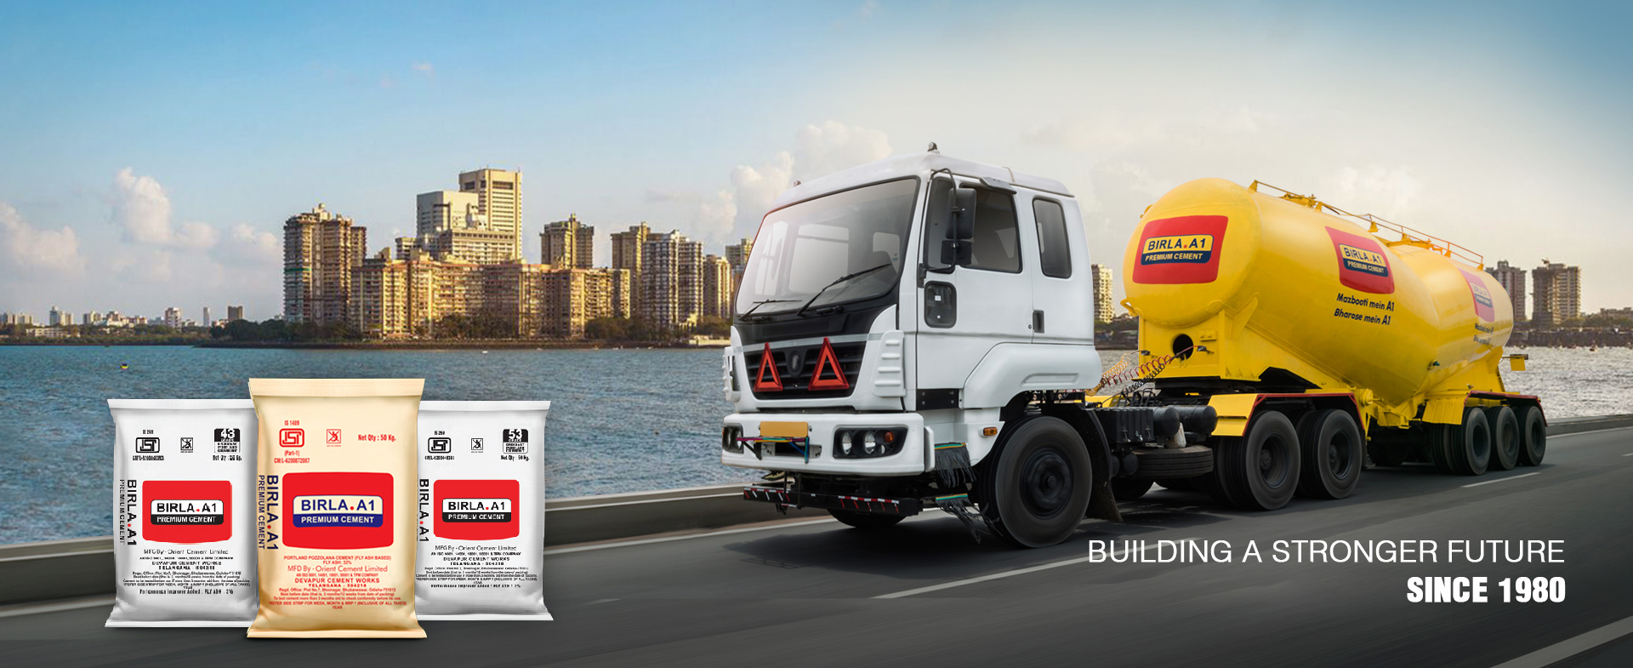

T R A N S P O R T E R P O R T A L
Vendor details and version

Slide 3


T R A N S P O R T E R P O R T A L
MEMBER LOGIN
User Name
Password
Forgot Password
SIGN IN
Vendor details and version

Slide 4
There are two options for transporter: either he can be in rcm or not.
If rcm is no, it means that they comes under 12% gst.
We have a list in database for those transporters : (will be shared).
For those transporters under 12% gst: total tax value is can be either igst-12% or cgst-6% and sgst:6%
If rcm is yes, leave the gst values as blank

Slide 5
Calculation of igst and cgst/sgst
For 12% gst(rcm=no)
If a=b,
Cgst:6%
sgst:6%
Of total amount
a
b
Calculation of igst and cgst/sgst
For 12% gst(rcm=no)
If a not equal to b,
Igst=12%
Of total amount

Slide 6
Invoice ready tab

Slide 7

Invoice ready
Click submit after selecting invoices
SUBMIT
LR No :
LR Date :
PO Number#1 | Counter left: 2
Invoice No | SHIPMENT NO | INVOICE DATE | Vehicle no | Destination | Party-Name | Lr no | Order type | Qty | RATE | Total | Invoice distance | Distance to unloading location | LR Upload | Customer ackn | destination | Generate Invoice | STATUS
1234 | 5374891` | 01-008-291 | abch10 | latur | Srk agency | 123 | direct | 20 | 100 | 2000 | 100 | 110
1234 | 5374891` | 01-008-291 | abch10 | latur | Srk agency | 123 | direct | 20 | 100 | 2000 | 100 | 110
1234 | 5374891` | 01-008-291 | abch10 | latur | Srk agency | 123 | direct | 20 | 100 | 2000 | 100 | 110
PO Number#2 | Counter left
Invoice No | SHIPMENT NO | INVOICE DATE | Vehicle no | Destination | Party-Name | Lr no | Order type | Qty | RATE | Total | Invoice distance | Distance to unloading location | LR Upload | Customer ackn | Generate Invoice | STATUS
Invoice No | SHIPMENT NO | INVOICE DATE | Vehicle no | Destination | Party-Name | Lr no | Order type | Qty | RATE | Total | Invoice distance | Distance to unloading location | LR Upload | Customer ackn | Generate Invoice | STATUS

Slide 8
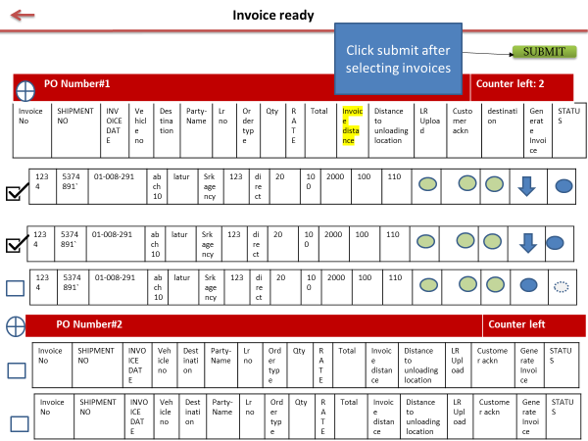
Kindly provide invoice number for pdf
AABBCCD
SUBMIT

Slide 9
INVOICE NUMBER SHOULD APPEAR HERE

